Slide 1
Enlighten Notification Service

Slide 2
Notification Function as Service
What is Notification Function as Service?
Common service for configuring and delivering various forms of communications (In app error/warning messages, Email Notifications, Banners, Push based notifications, Text messages etc)
Each of the following can be configured in real time
Template of the notification
Content of the notification
Delivery mechanism etc. [Sendgrid, Twillio]
Preference
Banner campaigns- configuring and scheduling
How this helps?
Reduces the effort of coding: Streamline notification creation, editing, and scheduling
Enables ad-hoc communication: Quickly send targeted notifications as needed
Improves scalability and efficiency: Handle large volumes of notifications reliably

Slide 3
FaaS Workflow
Events FAAS
Notification FAAS
Event is triggered from ENV or generated from ENL
As soon as notification has to be triggered – Events FAAS calls Notification FAAS
Define the logic to handle the ENV events
Ability to define the rules to generate events from ENL telemetry data
Ability to define actions for each events based on escalation policy
Events FAAS has the list of all notification ids to which corresponding events are mapped
So, action for one event can be – Trigger notifications, Trigger Event History, Show in Devices page etc
Has the configurable logic of all notifications including –
template,
content,
delivery mechanism etc.
Preference
User role
Based on #1,notification is triggered by this service
3. Logs are maintained

Slide 4
Notification Service: Core Components
Notification Manager
Delivery mechanism
Support multiple channels (email, SMS, push notifications, in-app banners)
Required for adding new delivery mechanism and associated service
Notification Template Management
Corresponding to each delivery mechanisms, templates will be defined [Template 1 for Errors, Template 2 for Alerts]
This will be used in Notification Management while adding the details of each notification
Notification Definition
Notification is created with the meta data [Id, title, Applicable Medium] and defined as per the medium and template defined in #2
Each notification will be mapped to user preference, and content is added as per user locale and user role
Workflow is attached for review and approval
Change log
Capture the logs of all administrative changes
Notification Dispatcher
Sending the Notification: Receives the trigger from different service which calls this module, Pulls all the data from the trigger API and #1 above, Send to users. This is completely backend
Logging and analytics: Records the logs of all the notifications send to user. We should be able to see all notification send to any users.
Campaign Module [Consumer of #1 and #2]
Capability to send ad-hoc notifications, or in-app banners
Externalize the module: This module can be made to exposed to external users [installers] with a proper workflow so that they can also publish campaign for HOs

Slide 5
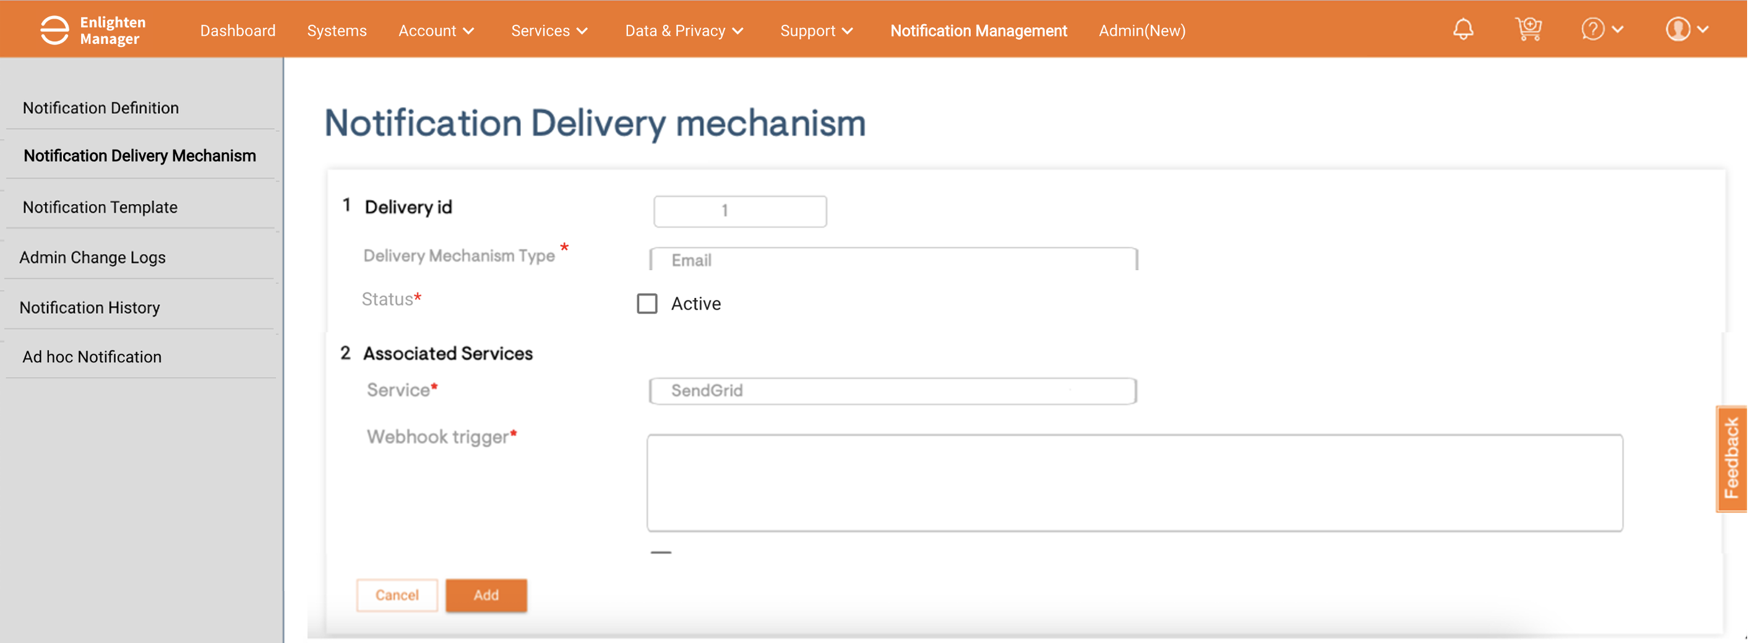
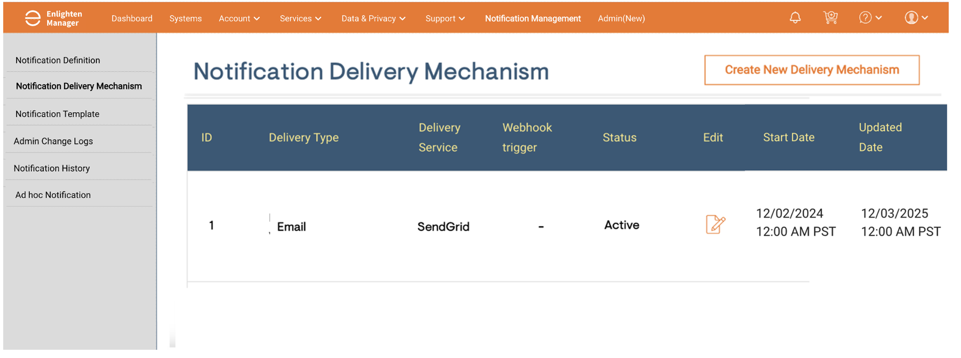
1.1 Delivery Mechanism Definition
Purpose: The delivery mechanism acts as a central repository for all available notification channels and their configurations. It ensures that each notification uses a predefined and reliable method for dispatch.
Core Fields:
Field Name | Description | Constraints
Delivery ID | A unique identifier for each delivery mechanism | Immutable and system-generated, e.g., 1XX
Delivery Mechanism Type | Specifies the type of mechanism (e.g., Email, SMS, Push Notification, Banner) | Like Email, SMS, Push Notification
Service | The external service provider associated with the mechanism (e.g., SendGrid, Twilio, Firebase) | Integration setup, e.g., SendGrid for Email.
Status | Indicates whether the mechanism is active or inactive | Values: Active, Inactive.
Created At | Timestamp indicating when the delivery mechanism was created | Auto-populated, e.g., 12/02/2024 12:00 AM PST
Updated At | Timestamp indicating the last time the delivery mechanism was updated. | Auto-updated when changes are made.
Additional Configurations | Any extra metadata or settings required by the service (e.g., API keys, callback URLs, webhooks). | Flexible to support provider-specific configurations.
Benefits of having this as a separate component:
Flexibility: Allows the system to adapt to new communication channels by adding custom mechanisms via the admin interface
E.g.: WhatsApp can be added as a custom delivery mechanism through the dashboard by defining the necessary API endpoint and authentication details
Scalability: As new delivery channels emerge, they can be added to the system without disrupting the existing setup
Centralized Management: All configurations for both predefined and custom delivery mechanisms are stored in the database, making it easy to manage
Customizable: Admins can adjust the configurations based on specific service requirements.

Slide 6
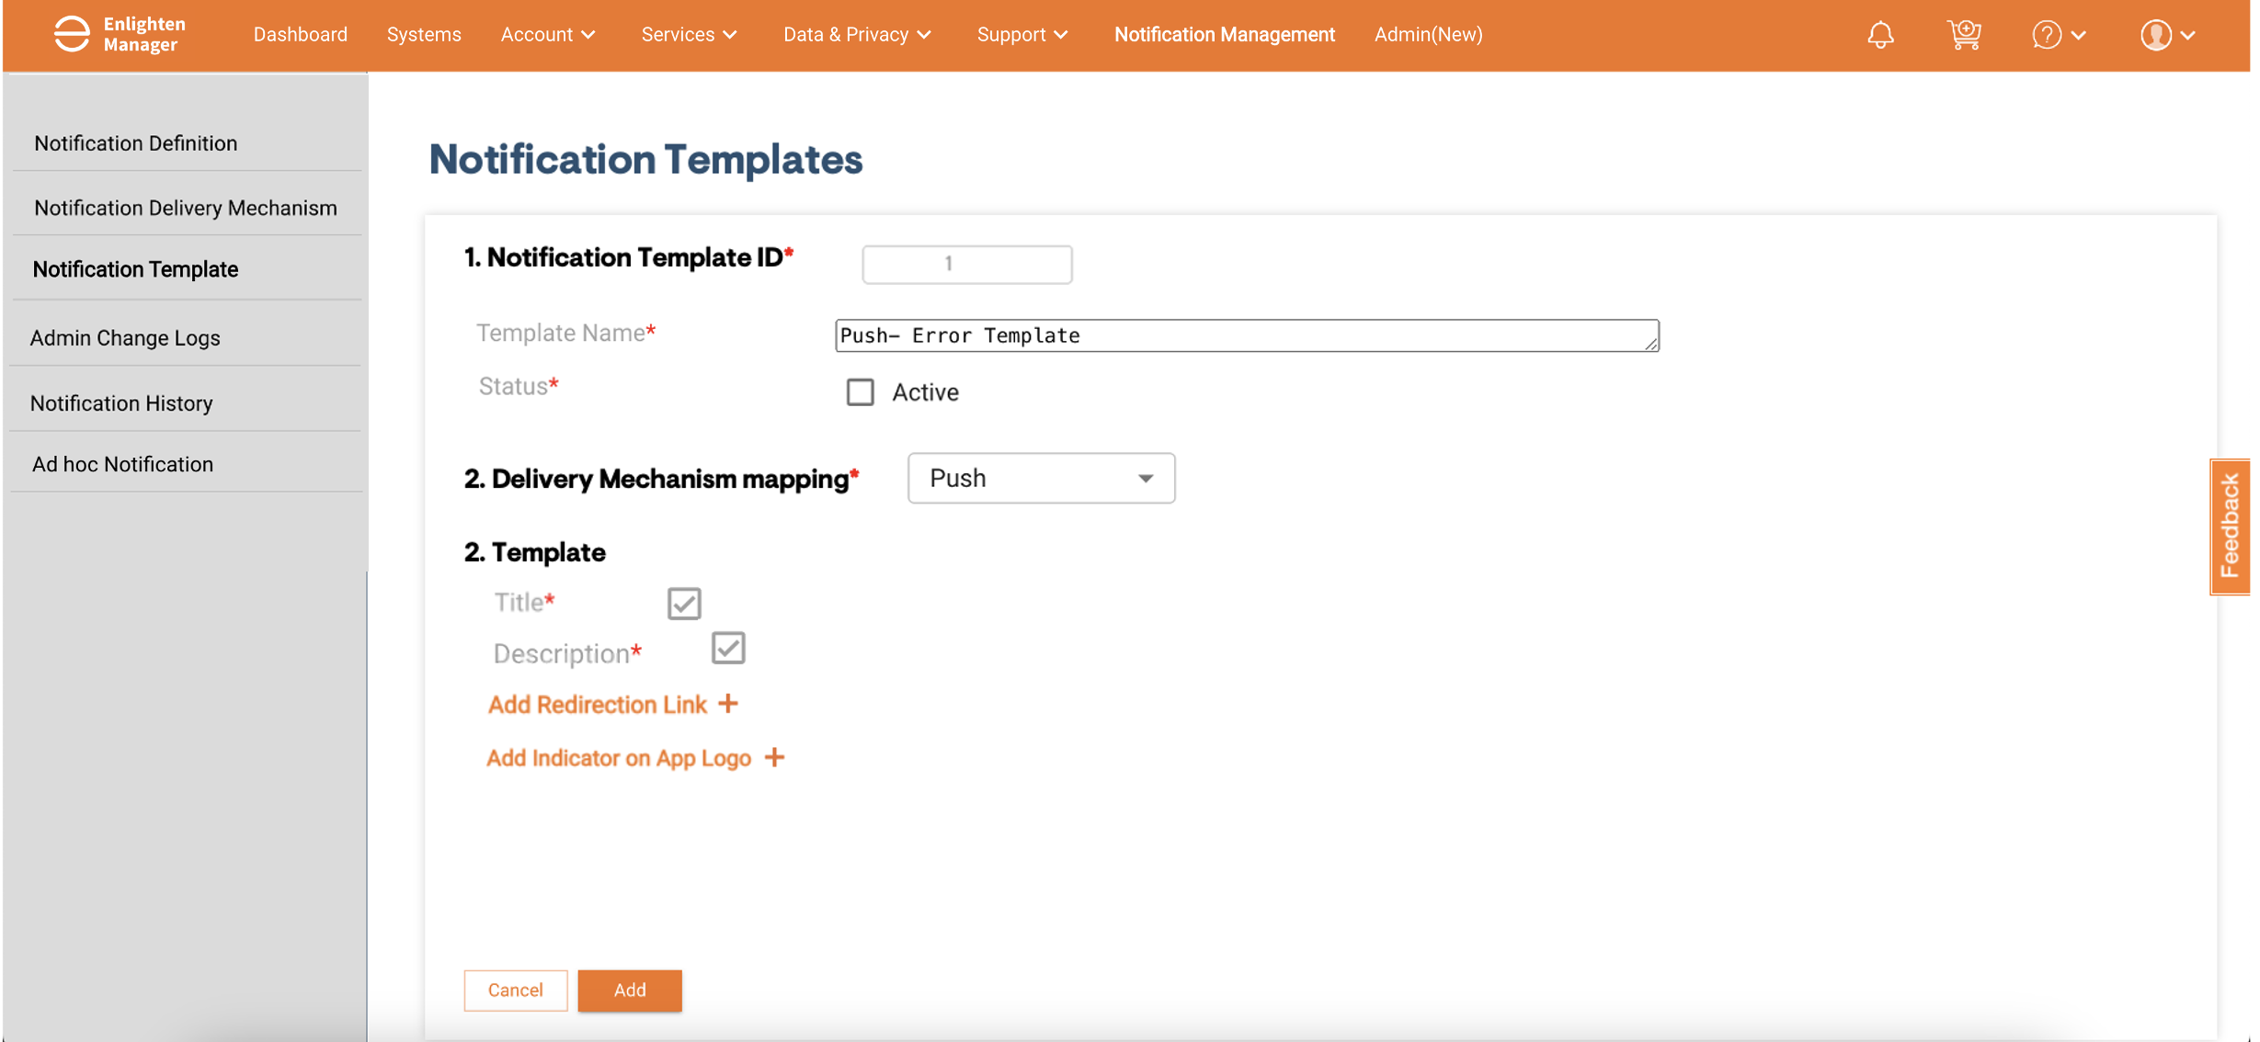
1.2 : Notification Template Management
Purpose: Notification Template Management module is designed to provide defined structure for each delivery mechanism (one-to-many mapping)
Field | Description | Type
Notification Template ID | Unique identifier for the notification template | System generated ID
Template Name | Custom-defined name of the notification template | Text (String)
Delivery Mechanisms | Predefined mechanisms selected from the list (Email, SMS, Push Notification, etc.). | Single-select Dropdown
Template | Pre-defined templates would be present New templates can be created using custom fields | Form
Active | Indicates if the template is Active or Inactive. | Boolean (Checkbox)
Created At | Timestamp indicating when the template was created. | Timestamp
Updated At | Timestamp indicating the last time the template was updated. | Timestamp
Functional Requirements:
A repository of each template to be maintained within Notification Template Manager
Option to Edit and define custom template would be provided)
Each template should be mapped to Delivery mechanisms (defined in #1: Delivery Mechanism Definition) and would be classified accordingly
Template fields are explained in next slide

Slide 7
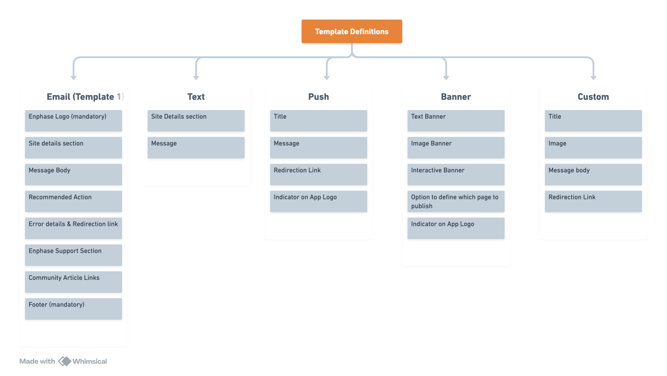
1.2: Notification Template Management
Corresponding to each delivery mechanism,
Pre-defined templates would be present (Can be configured further based on what parameters need to be shown)
For new delivery mechanisms, custom template can be used

Slide 8
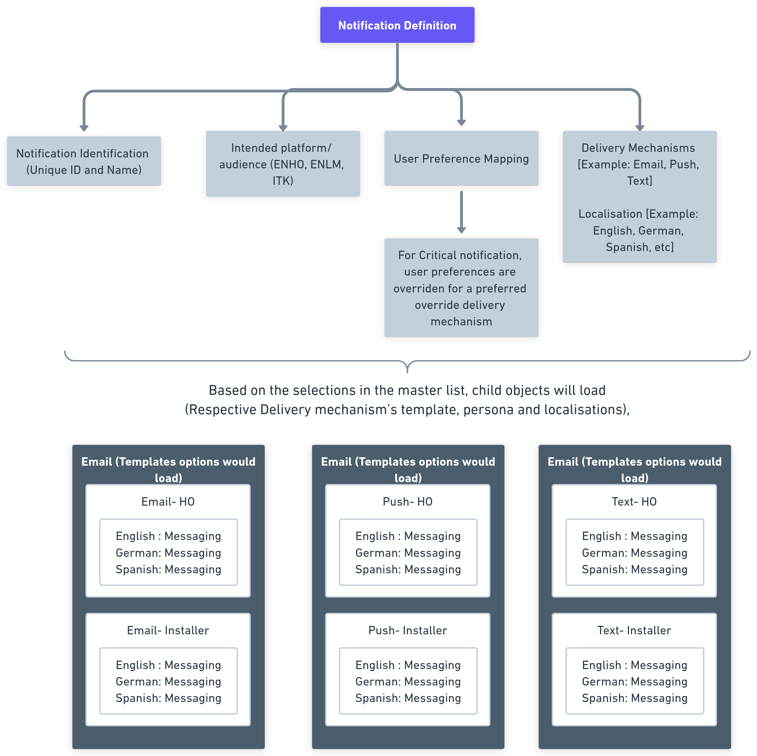
1.3 Notification Definition
Purpose: Provide a structured way to create and configure individual notifications, ensuring they are tailored to specific use cases and user needs. It acts as the foundational layer for defining the core properties, and content structure of notifications.
Functional Requirements:
A repository of all Notifications to be maintained within Enlighten Notifications.
Created and updated date should be auto-populated
Active/ Expired field will be there for each
Option to Edit and define new notification
Notification Templates would be fetched from Layer 2: Template Management
Content needs to be updated in child objects for each template, persona and applicable localization (defined in Master)
Master
Child objects

Slide 9
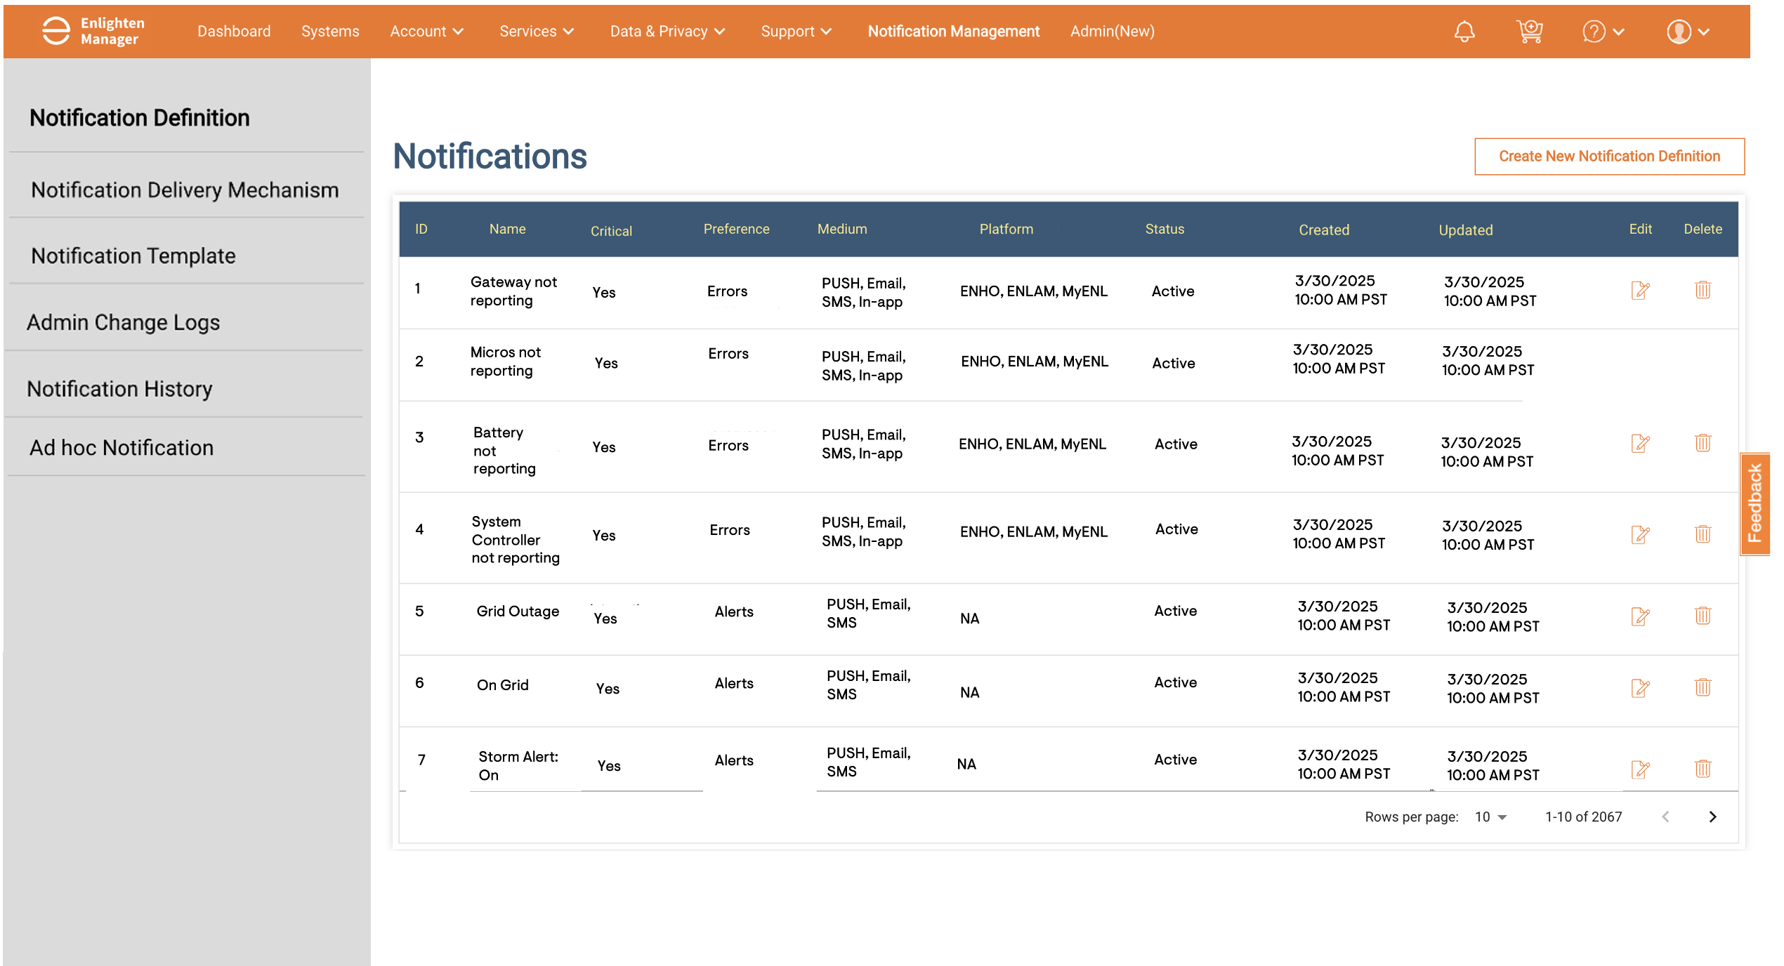
1.3 : Notification Definition

Slide 10
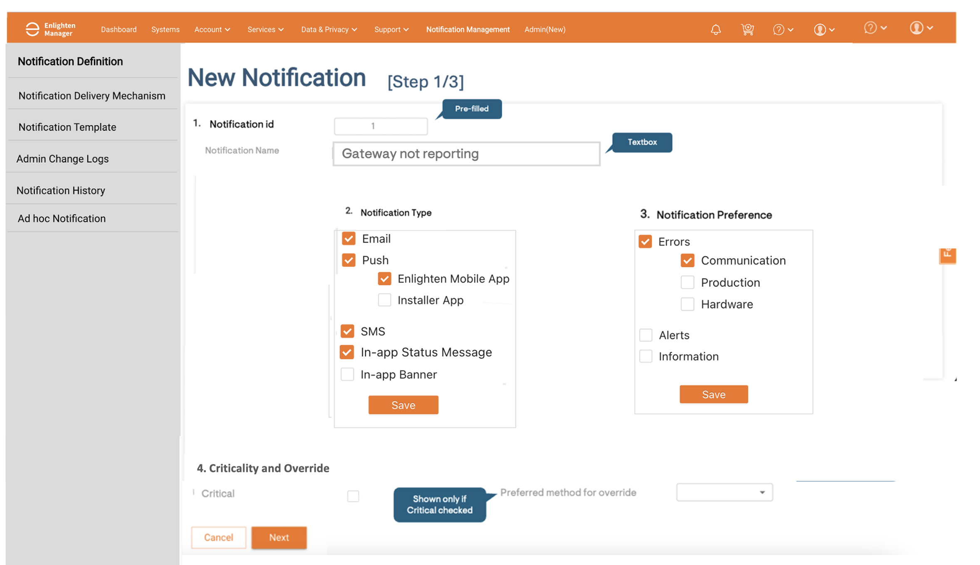
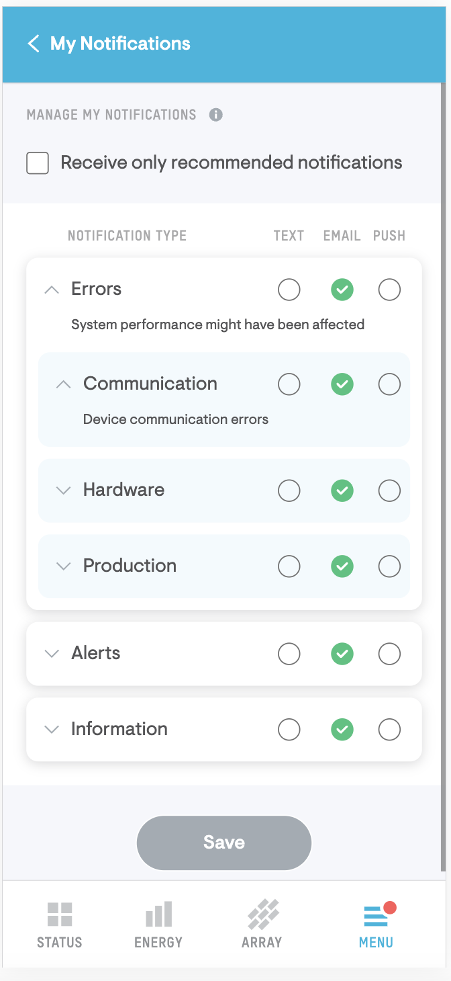
1.3 Notification Definition - Creating
Notification Preference Mapping
Master Definition

Slide 11
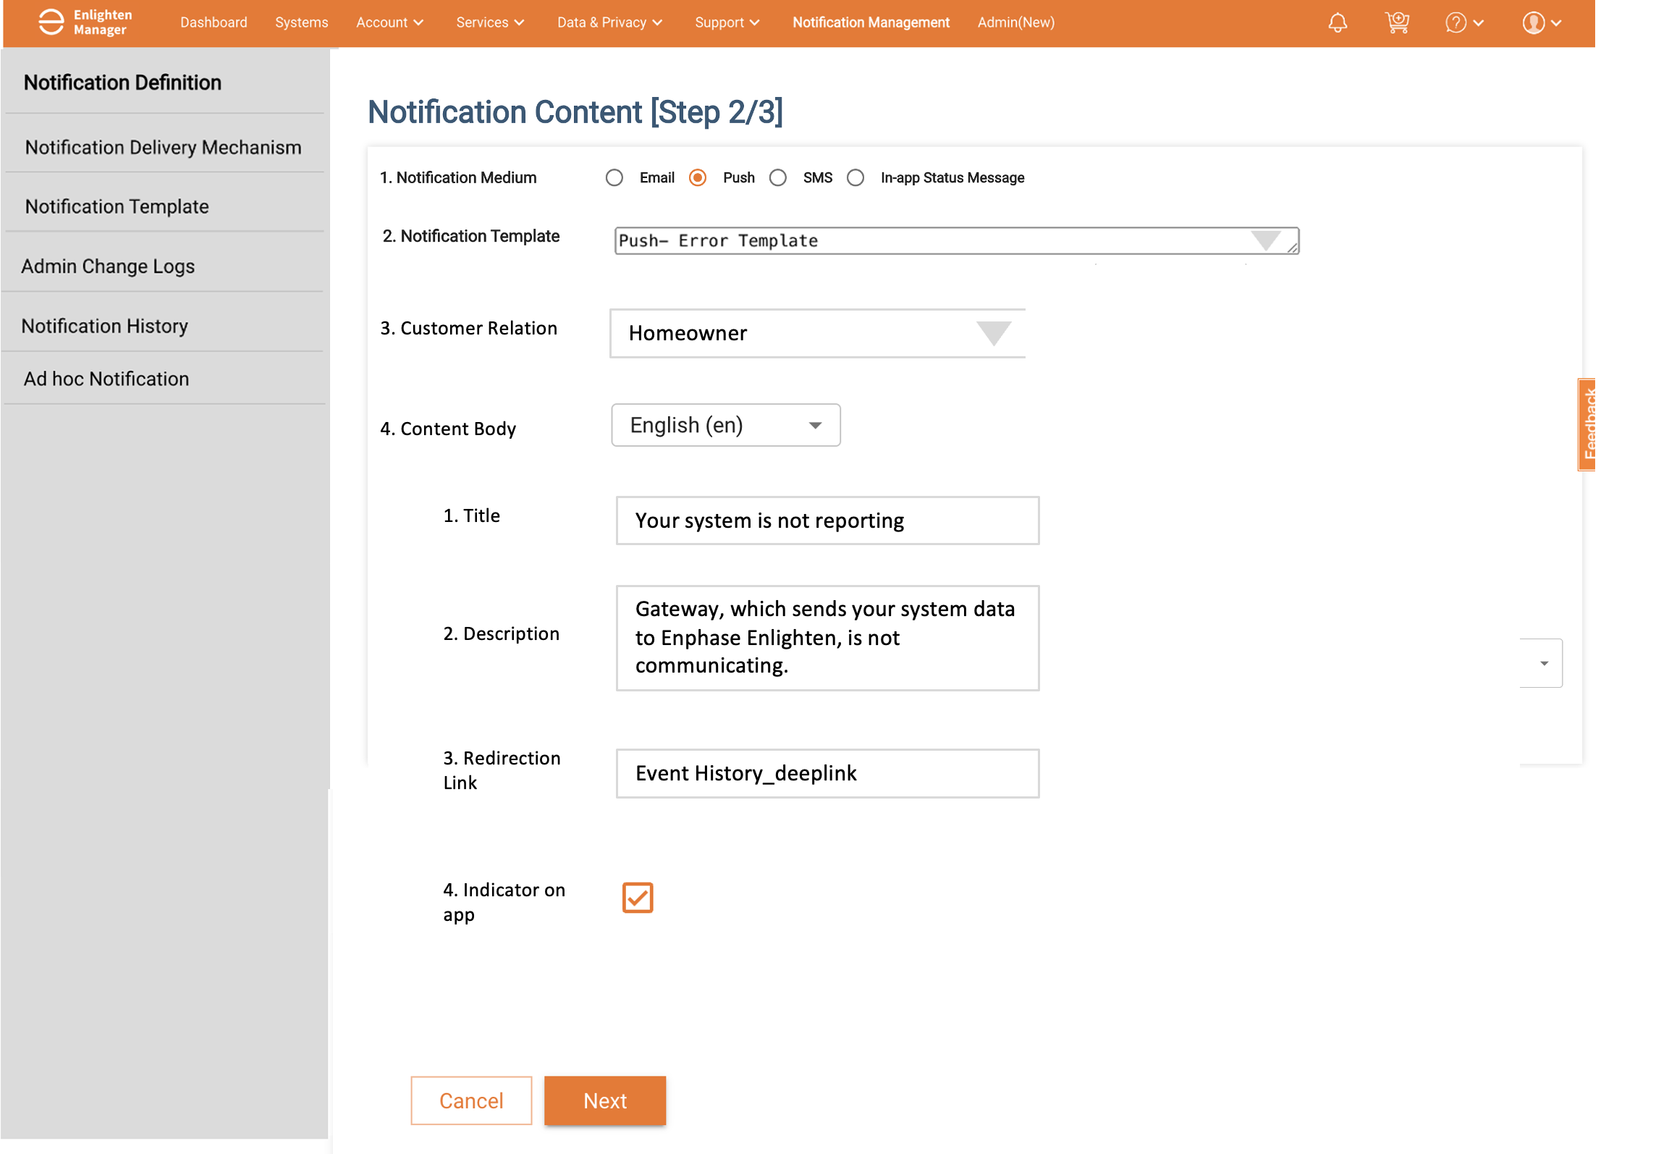
1.3 Notification Definition - Adding content
Based on the above selection of Notification Type, child objects will be created and pre-populated:
Purpose: Manage child objects associated with notifications.
Fields:
Notification Type: Each notification type is listed as a separate entry with template.
Message Content: Input localized content for different regions.
Action Items: Define actions available to the recipient (e.g., CTA, Dismiss).
Language: Dropdown to select the language for the content.

Slide 12
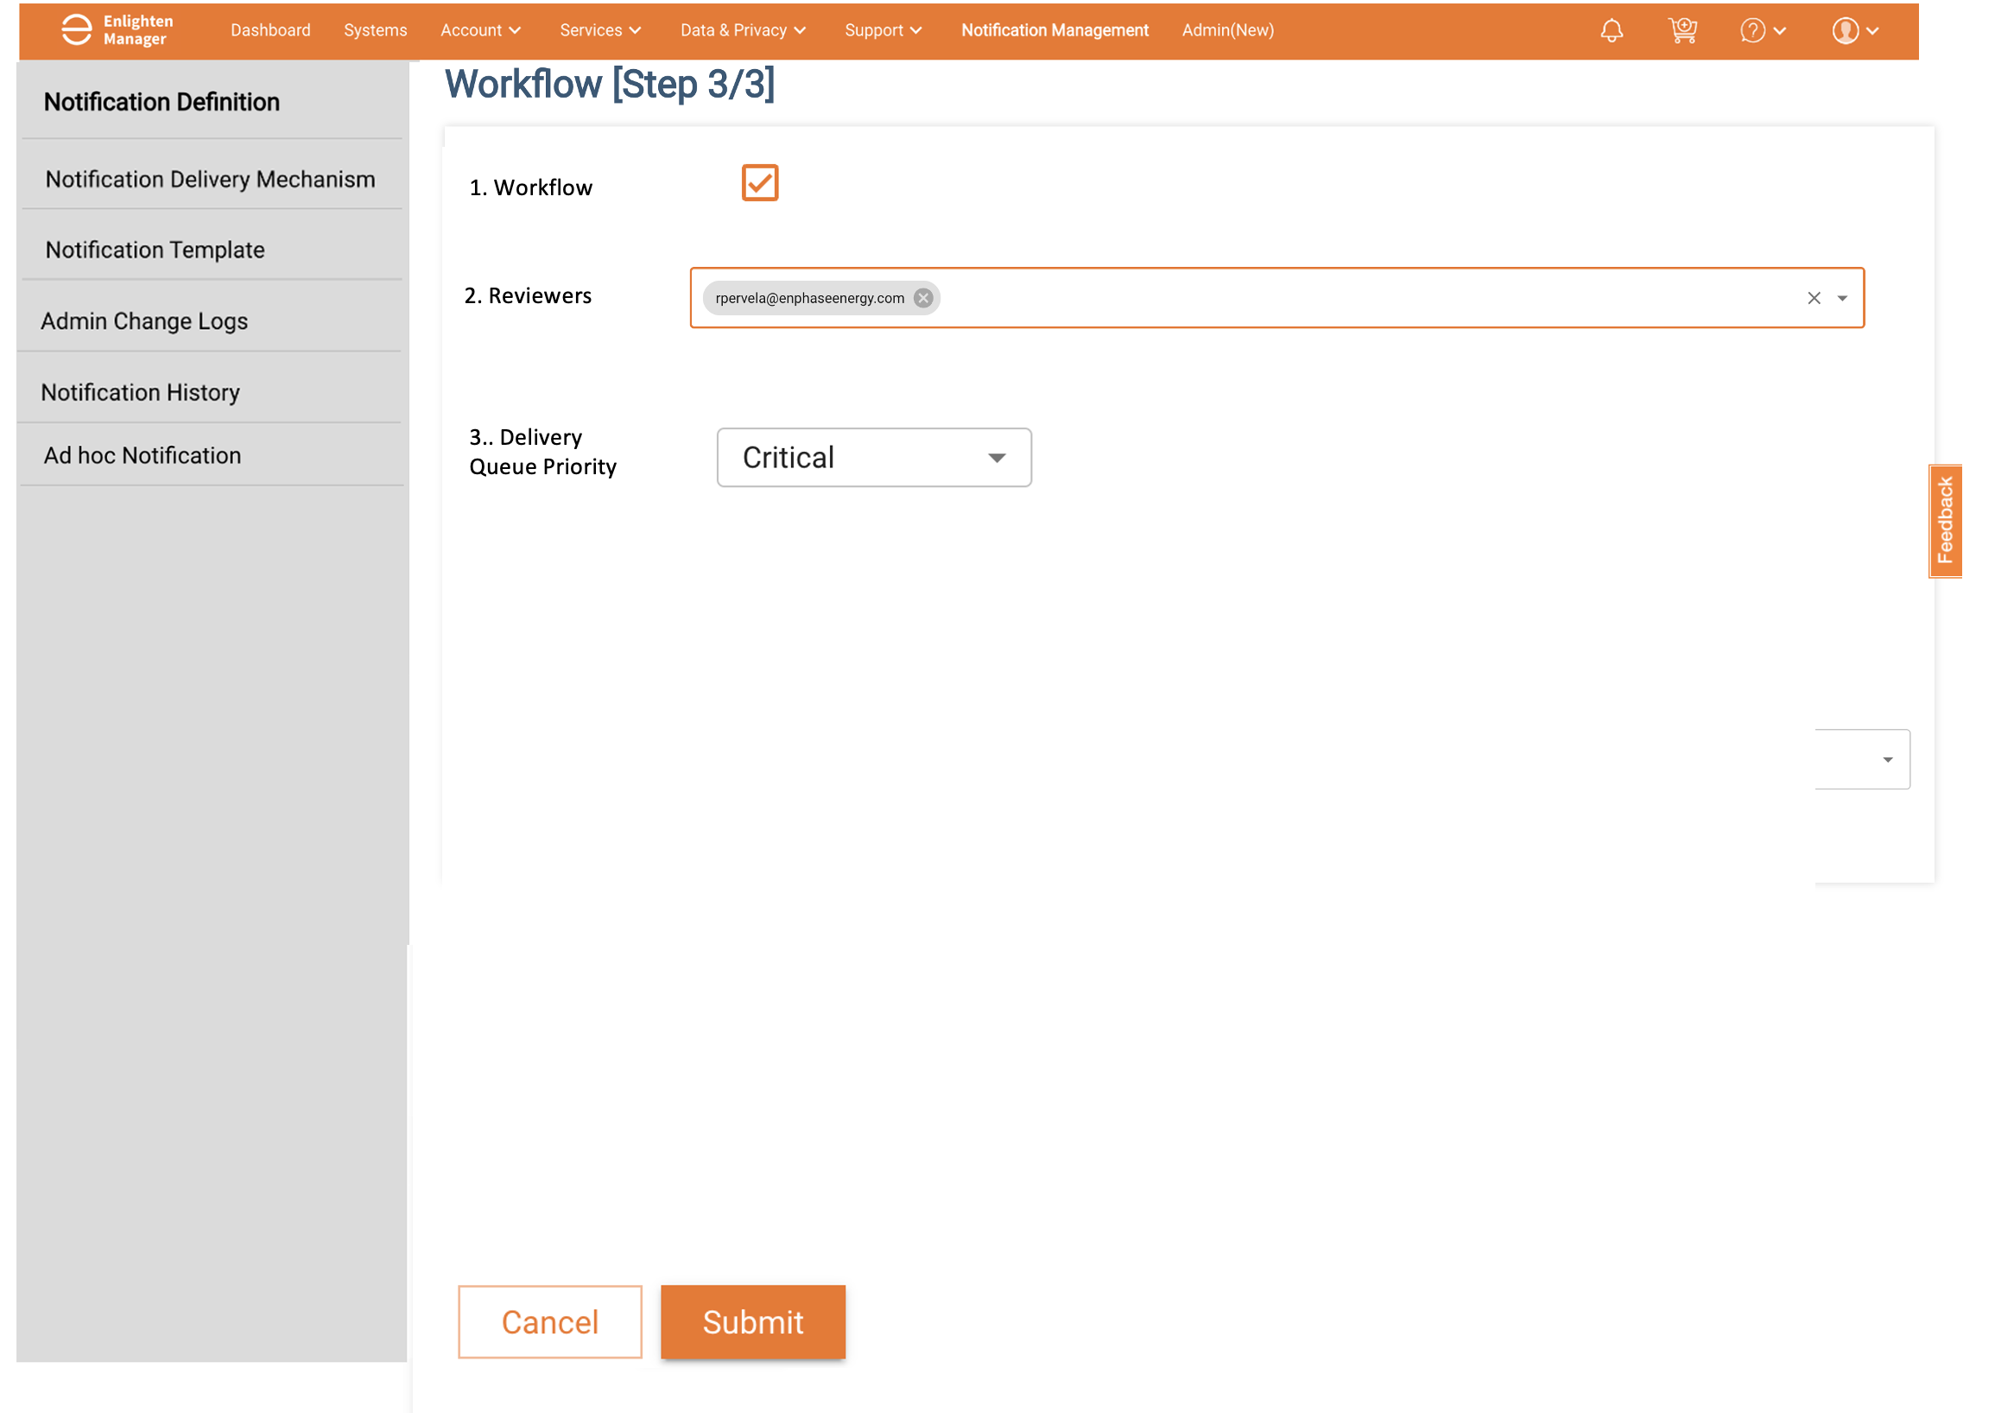
1.3 Attaching the workflow

Slide 13
2. Schedule worker and Dispatcher
5. Schedule Worker
Purpose: Backend process to manage schedule workers and queue the notifications to be sent.
Actions:
Read the schedule [Generated from Step 4]
Dispatch as per time
Queue the messages
6. Dispatcher
Purpose: Backend process to process the queue and dispatch messages as per the delivery mechanism in Step 1.
Actions:
De-queue the message
Invoke the respective delivery mechanism service to send the notification

Slide 14
Appendix

Slide 15
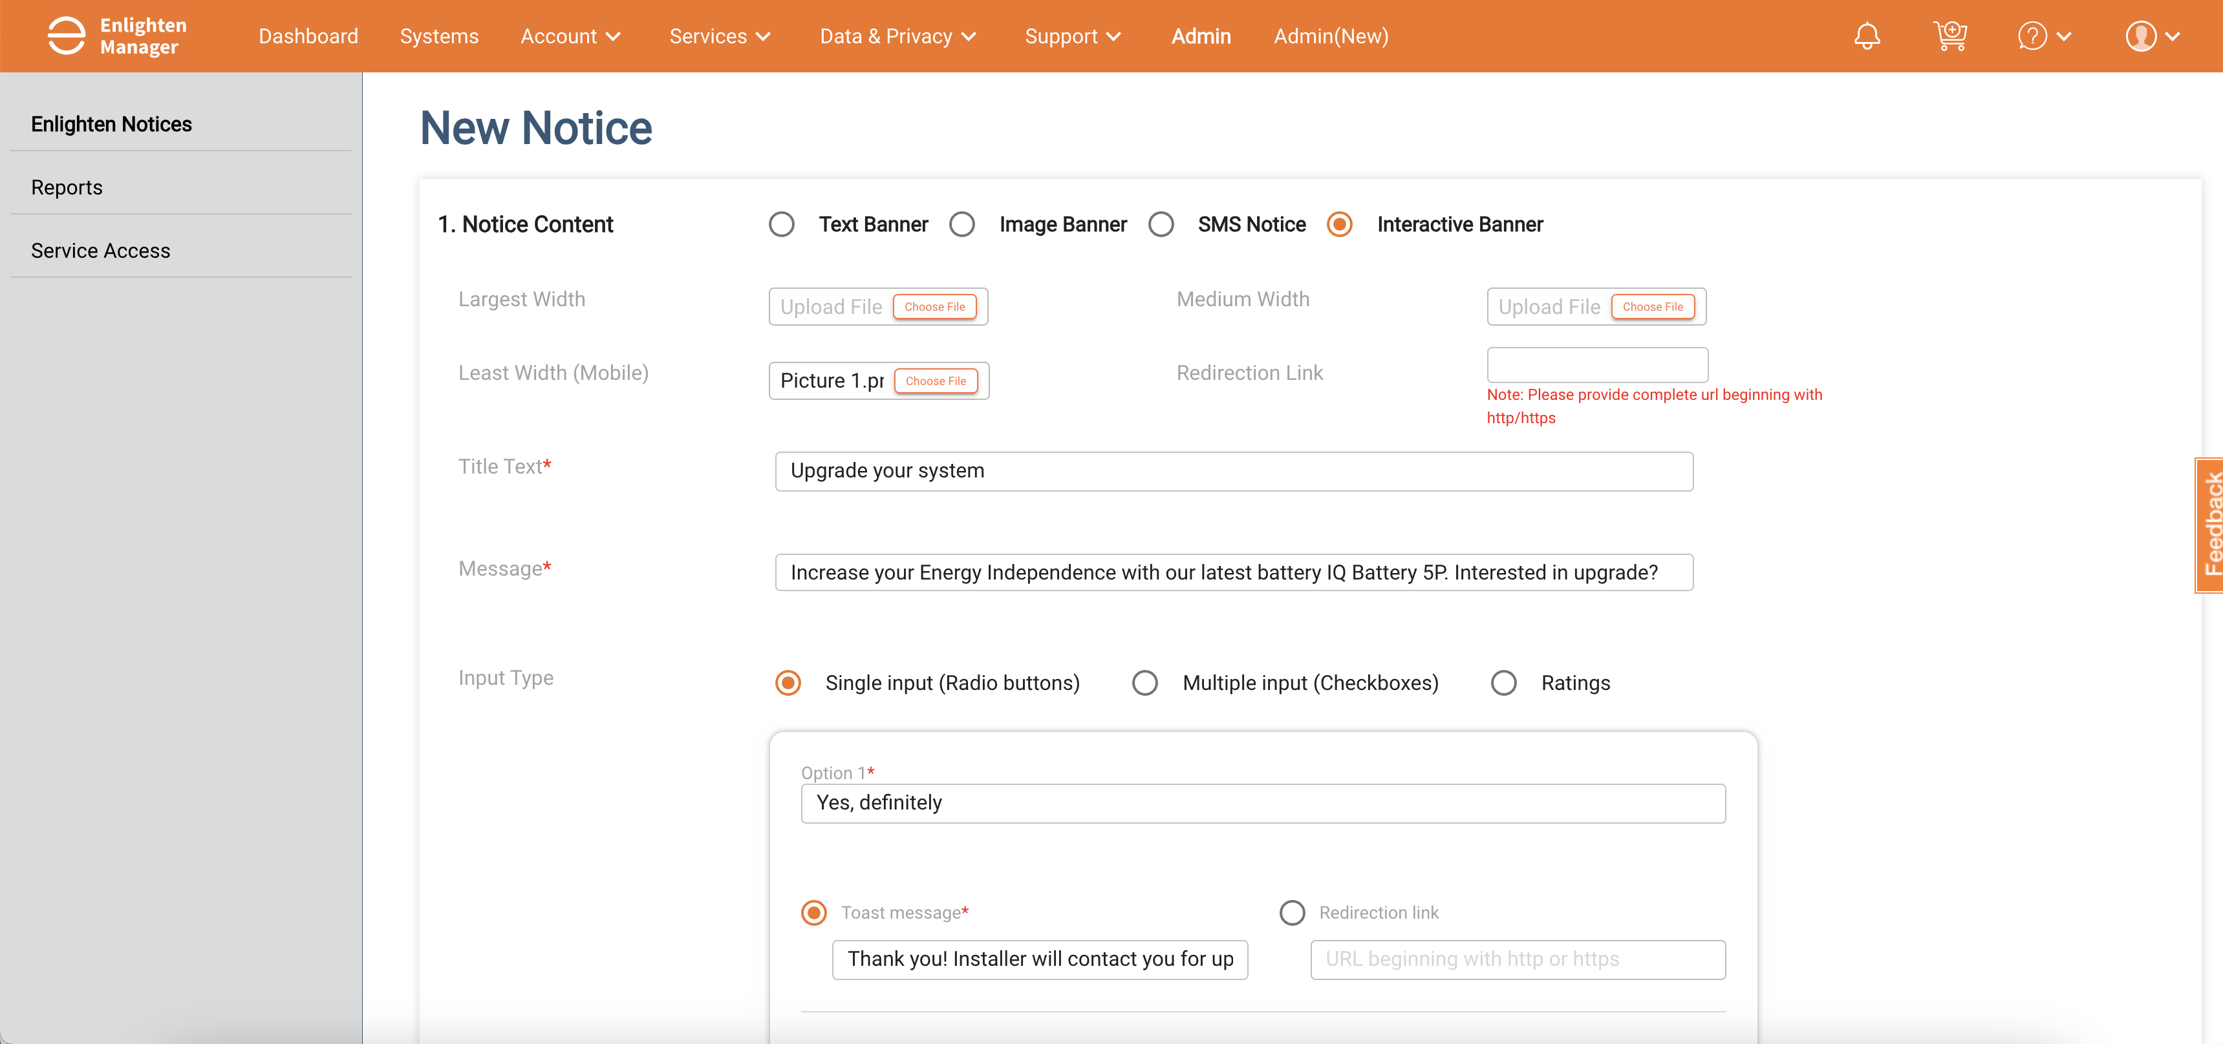
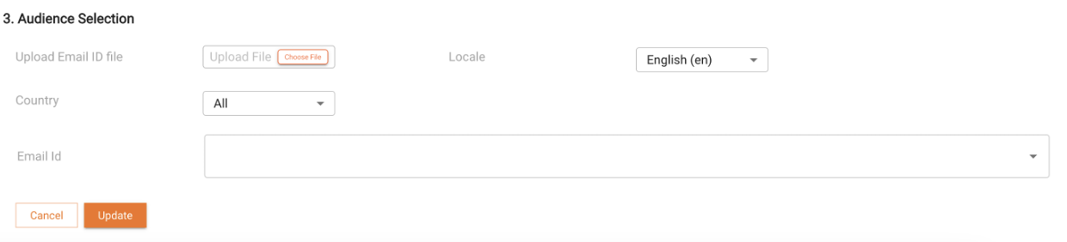
User Journey for Interactive Banner
2. Select id
PowerPack1_Campaign

Slide 16
Manual schedule – Externalize [Similar to Events OR copy of notification in manual also
In the notification definition, how the variables to be defined –
Battery reserve %
Storm name
Reports trigger from ENLAM, ENHO – where we can’t edit the templates, and data – how can it be handled
In-app message, events history, devices page should be part of notification or events

Slide 17
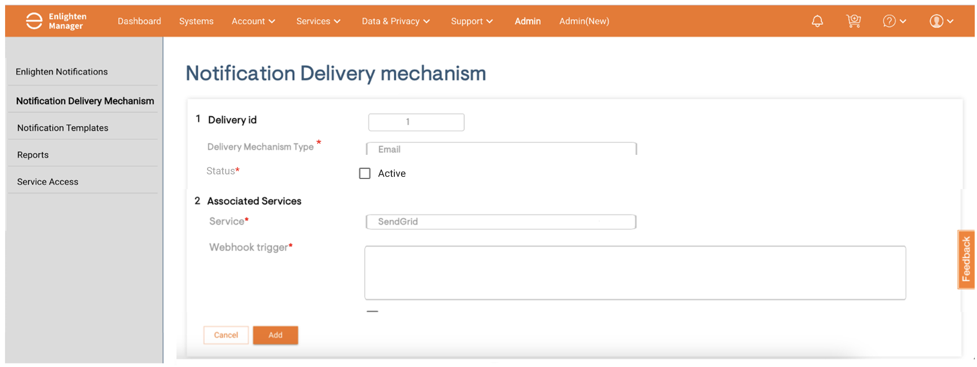
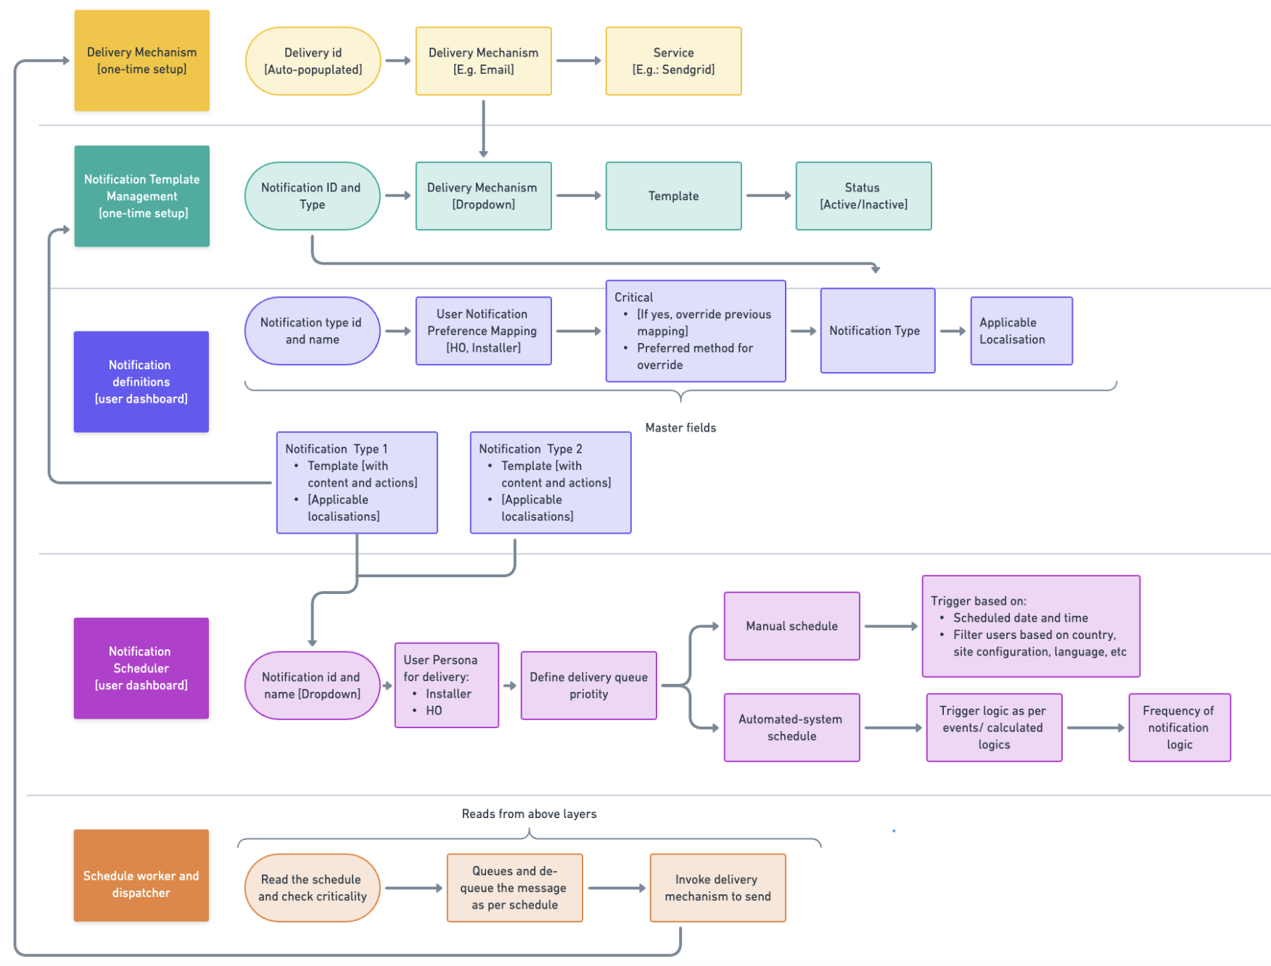
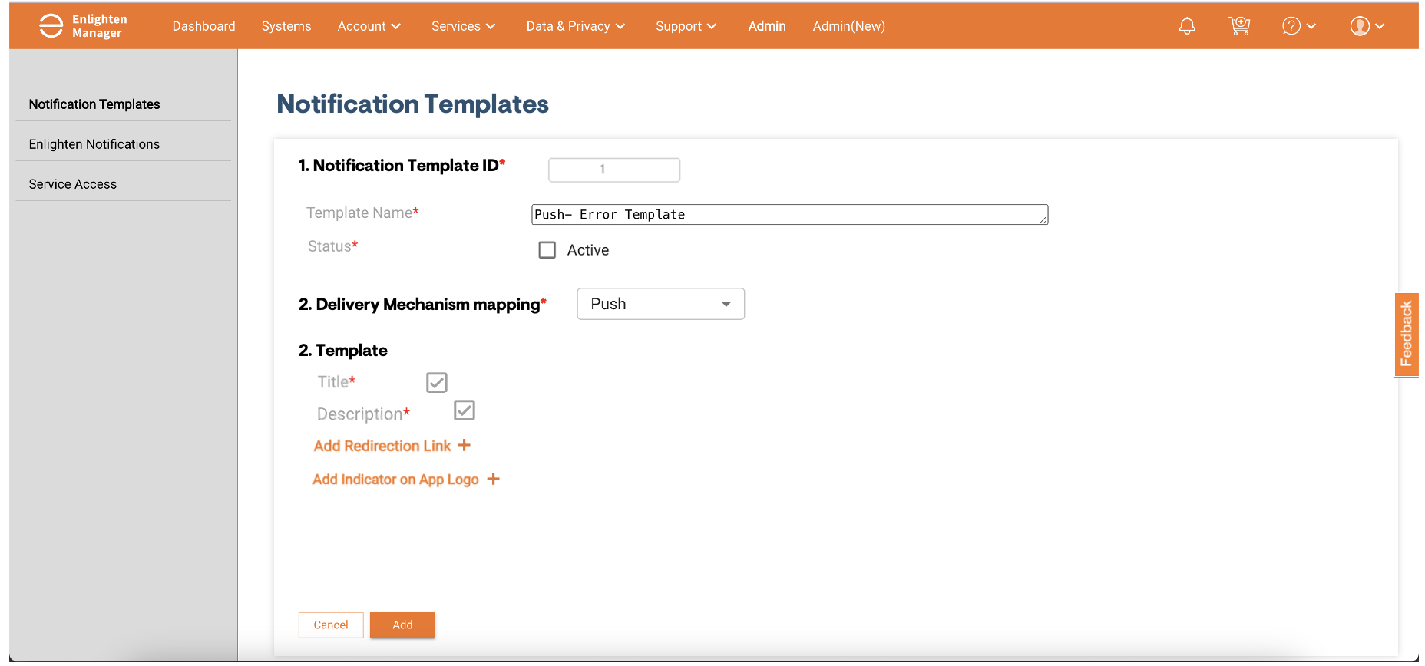
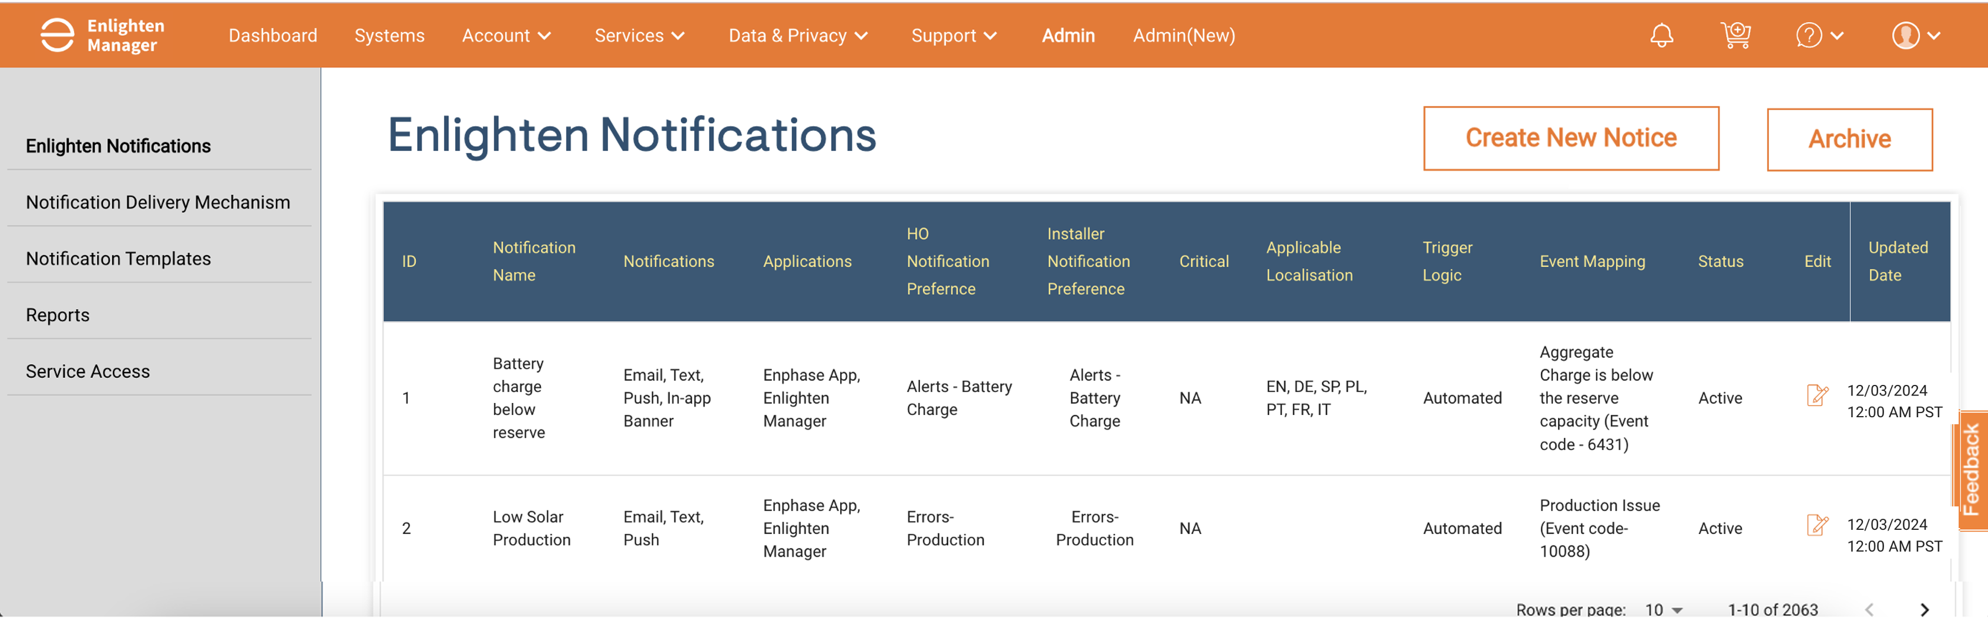
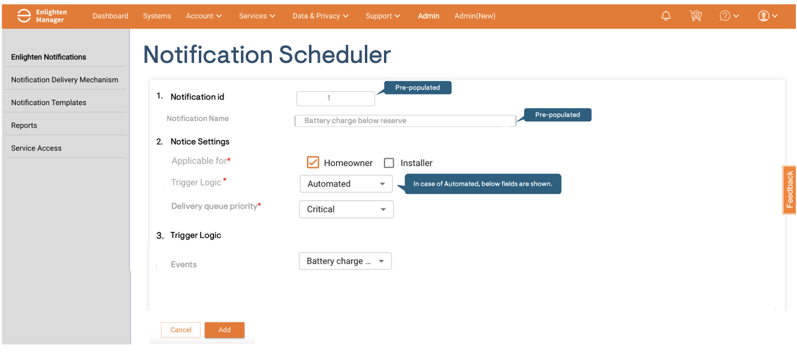
Notification Service: Interaction between Core Components

Slide 18
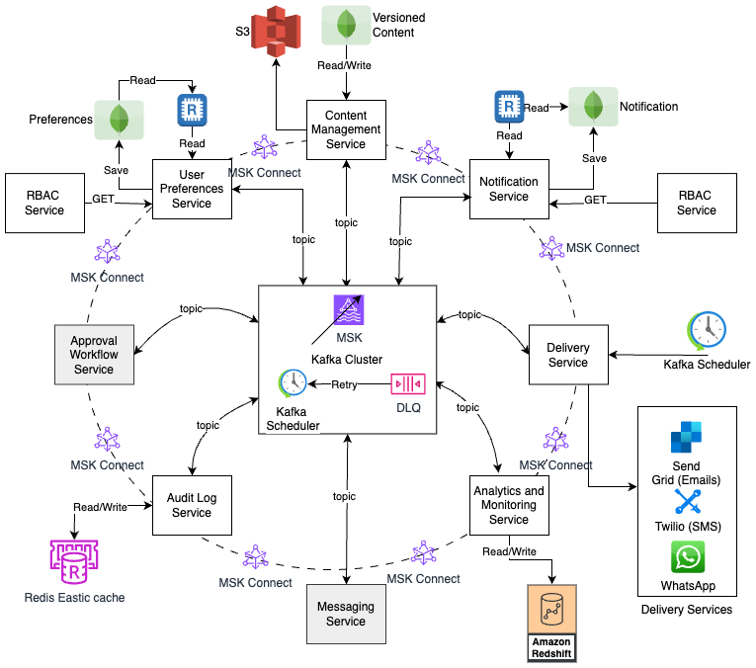
Notification Service: Architecture

Slide 19
Logs [Execution logs]
Audit logs [Change logs from admin]
Attaching workflow
Trigger logic to be in calling Module
Customer Relation

Slide 20
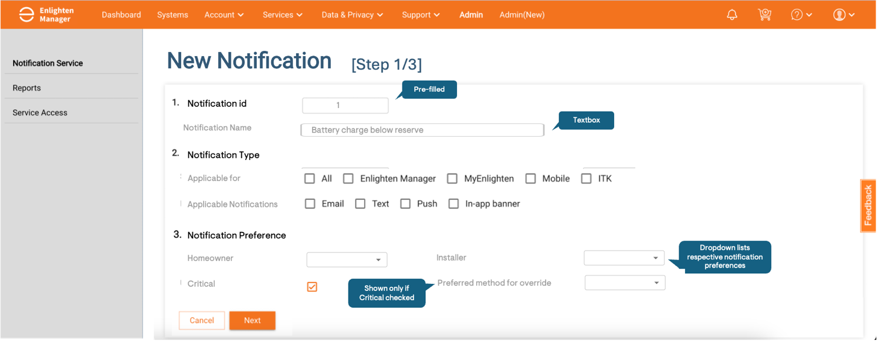
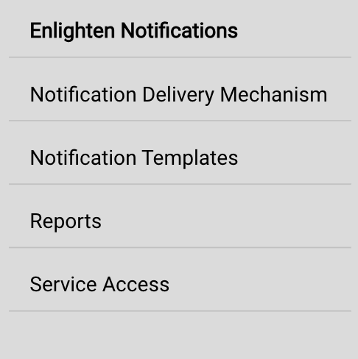
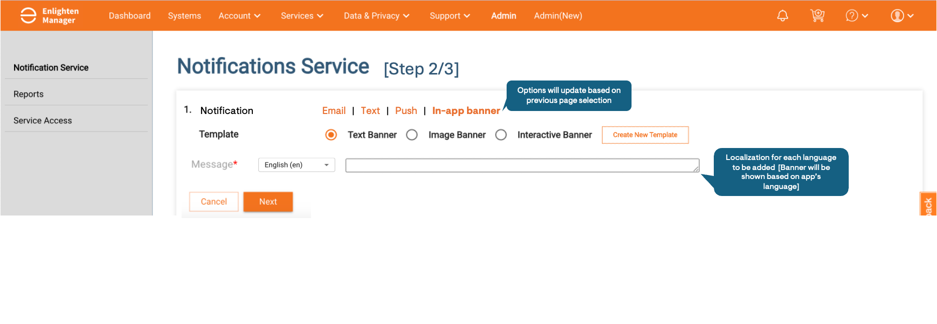
3. Notification Definition (2/2) - Creating
Notification Preference Mapping
Master Definition
Remove locale
Same preference mapping
Drop down for Applicable for and applicable notfication
Based on the above selection of Notification Type and Localisation, child objects will be created and pre-populated:
Purpose: Manage child objects associated with notifications.
Fields:
Notification Type: Each notification type is listed as a separate entry with template.
Message Content: Input localized content for different regions.
Action Items: Define actions available to the recipient (e.g., CTA, Dismiss).
Language: Dropdown to select the language for the content.
Take an example of PUSH
Template – should have drop down right?
Locale is here already
Customer Relation needed to be added here
HO
Installer
Installer Notification
HO Notification
[Step 3/3]

Slide 21
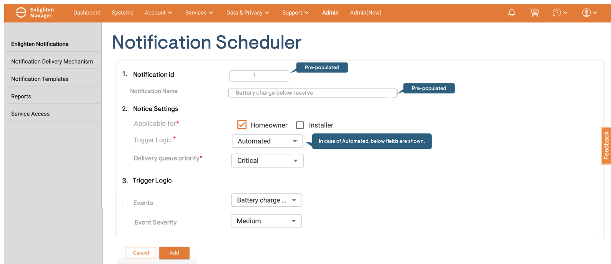



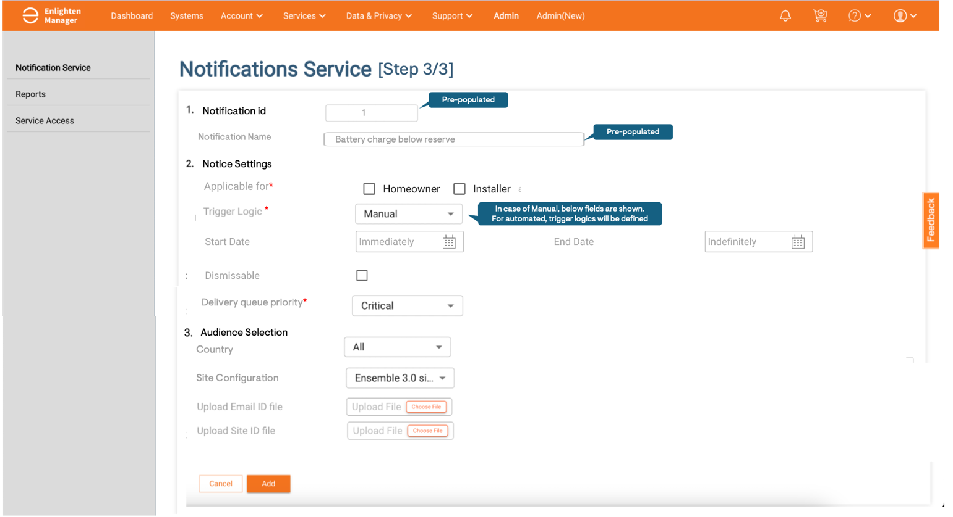
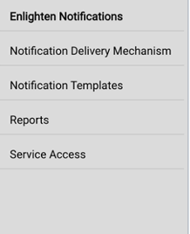
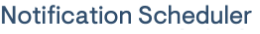
4. Notification Scheduler
Purpose: Provide a centralized interface for managing and automating the scheduling of notifications. It allows administrators to define when and how notifications are sent to users or systems, ensuring that timely and relevant information is delivered based on specific criteria.
If Automated notifications schedule is selected
Field Name | Description | Data Type | Constraints/Notes
Notification Name with ID | Dropdown to select a previously defined notification to be scheduled. | Dropdown (Notification ID) | Referencing existing notifications in the system.
Manual Scheduling / Automated | Indicates whether the notification is manually scheduled or system-automated. | Dropdown (Enum) | Options: Manual, Automated.
Dispatch Date & Time | Date and time when the notification will be dispatched. | DateTime | Required for manual scheduling, optional for automated scheduling.
Criteria | Conditions or criteria for dispatch of the notification. | Text / Conditional Logic | For manual: Filters users based on country, site config, language. For automated: Event-based triggers.
Trigger Logic (Automated) | Logic that governs the dispatch of notifications for automated scheduling based on event triggers or system logic. | Text / Conditional Logic | Tied to system events stored in Enlighten
User/Site Filters | Filters that allow the selection of specific users or sites based on criteria (for manual scheduling). | Multi-select (Array) | Options: Country, Site Configuration, Language, etc.
Actions | Actions for scheduling, such as Create, Update, Expiry. | Dropdown (Enum) | Options: Create, Update, Expiry.
If Manual schedule is selected
Note: For automated schedule, Event FaaS will call Notification FaaS for triggering notification whenever event is created

Slide 22
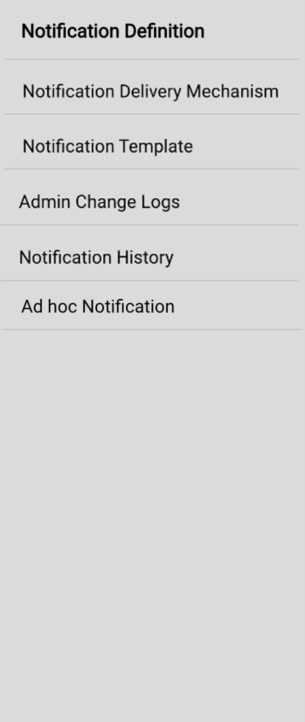
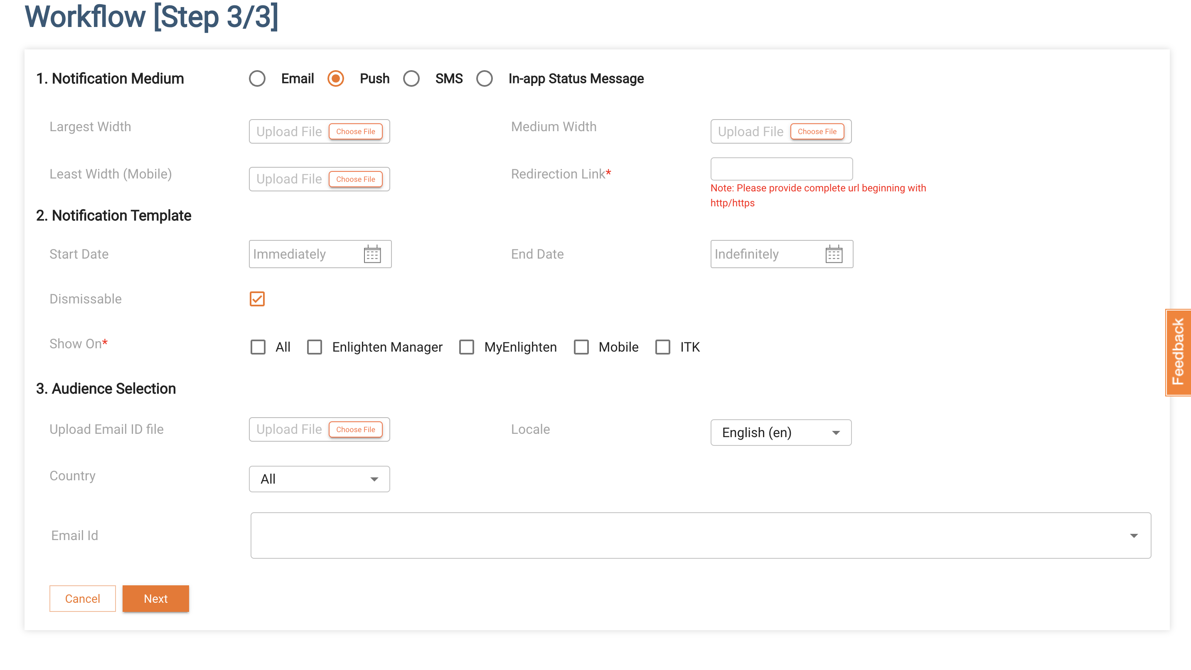
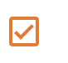
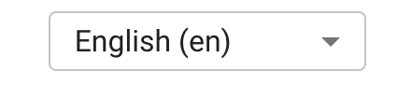
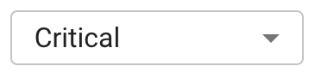

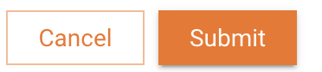
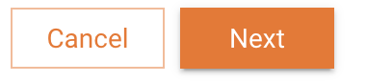
3. Customer Relation
1. Workflow
2. Reviewers
3.. Delivery Queue Priority

Slide 23
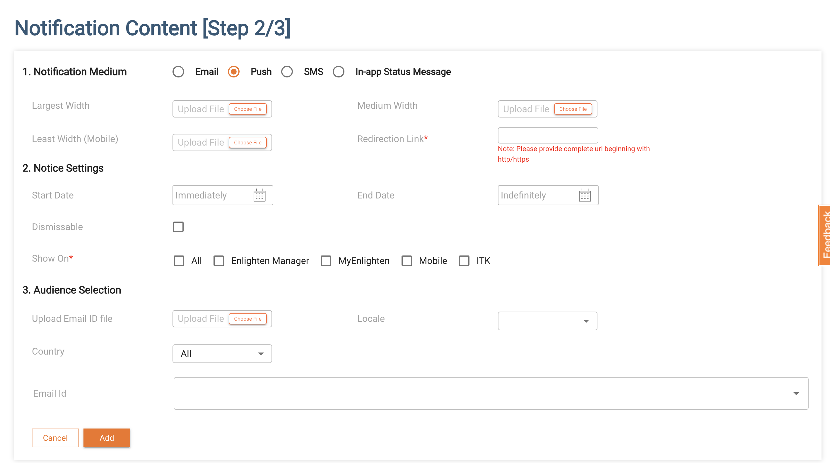
3. Customer Relation
Homeowner
4. Content Body
1. Title
Your system is not reporting
2. Description
Gateway, which sends your system data to Enphase Enlighten, is not communicating.
3. Redirection Link
Event History_deeplink
4. Indicator on app

Slide 24
Notification Service: Core Components
Delivery mechanism
Support multiple channels (email, SMS, push notifications, in-app banners)
Required for adding new delivery mechanism and associated service
Notification Template Management Corresponding to each delivery mechanisms, templates will be defined [Template 1, Template 2 for email]
Notification Definition
Notification can be defined as per the selection of #1 delivery mechanism and #2 template [Eg: Email , Template 1 for Monthly Report]
Each notification will be mapped to corresponding HO and installer Notification preference (only for critical cases, user preference can be overridden
New notifications can be defined with desired content as per template, localisation will be addressed
Notification Scheduler This will contain:
Notification Priority [for queue prioritisation]
Meant for HOs/Installers
Trigger Logic
Automated events – Event-based
Manual Trigger - Target audience and schedule
Notification Frequency
Backend:
Notification Worker & Dispatcher
Module would read from above layers and execute
Queues and de-queues the messages as per schedule
Invoke delivery mechanism (#1) to send

Slide 25
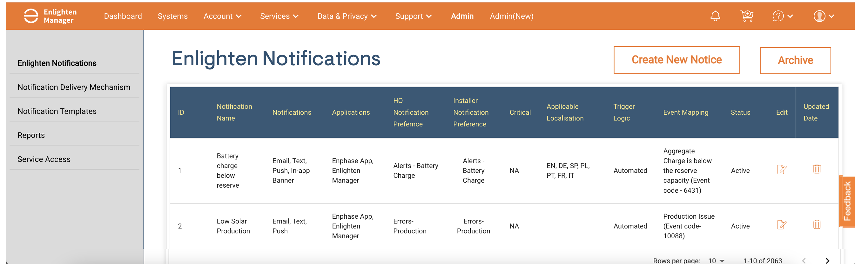

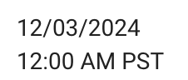
3 : Notification Definition
All active notifications will be listed here
Inactive notifications will be in archive
Existing active Notifications can be edited or Expired

Slide 26
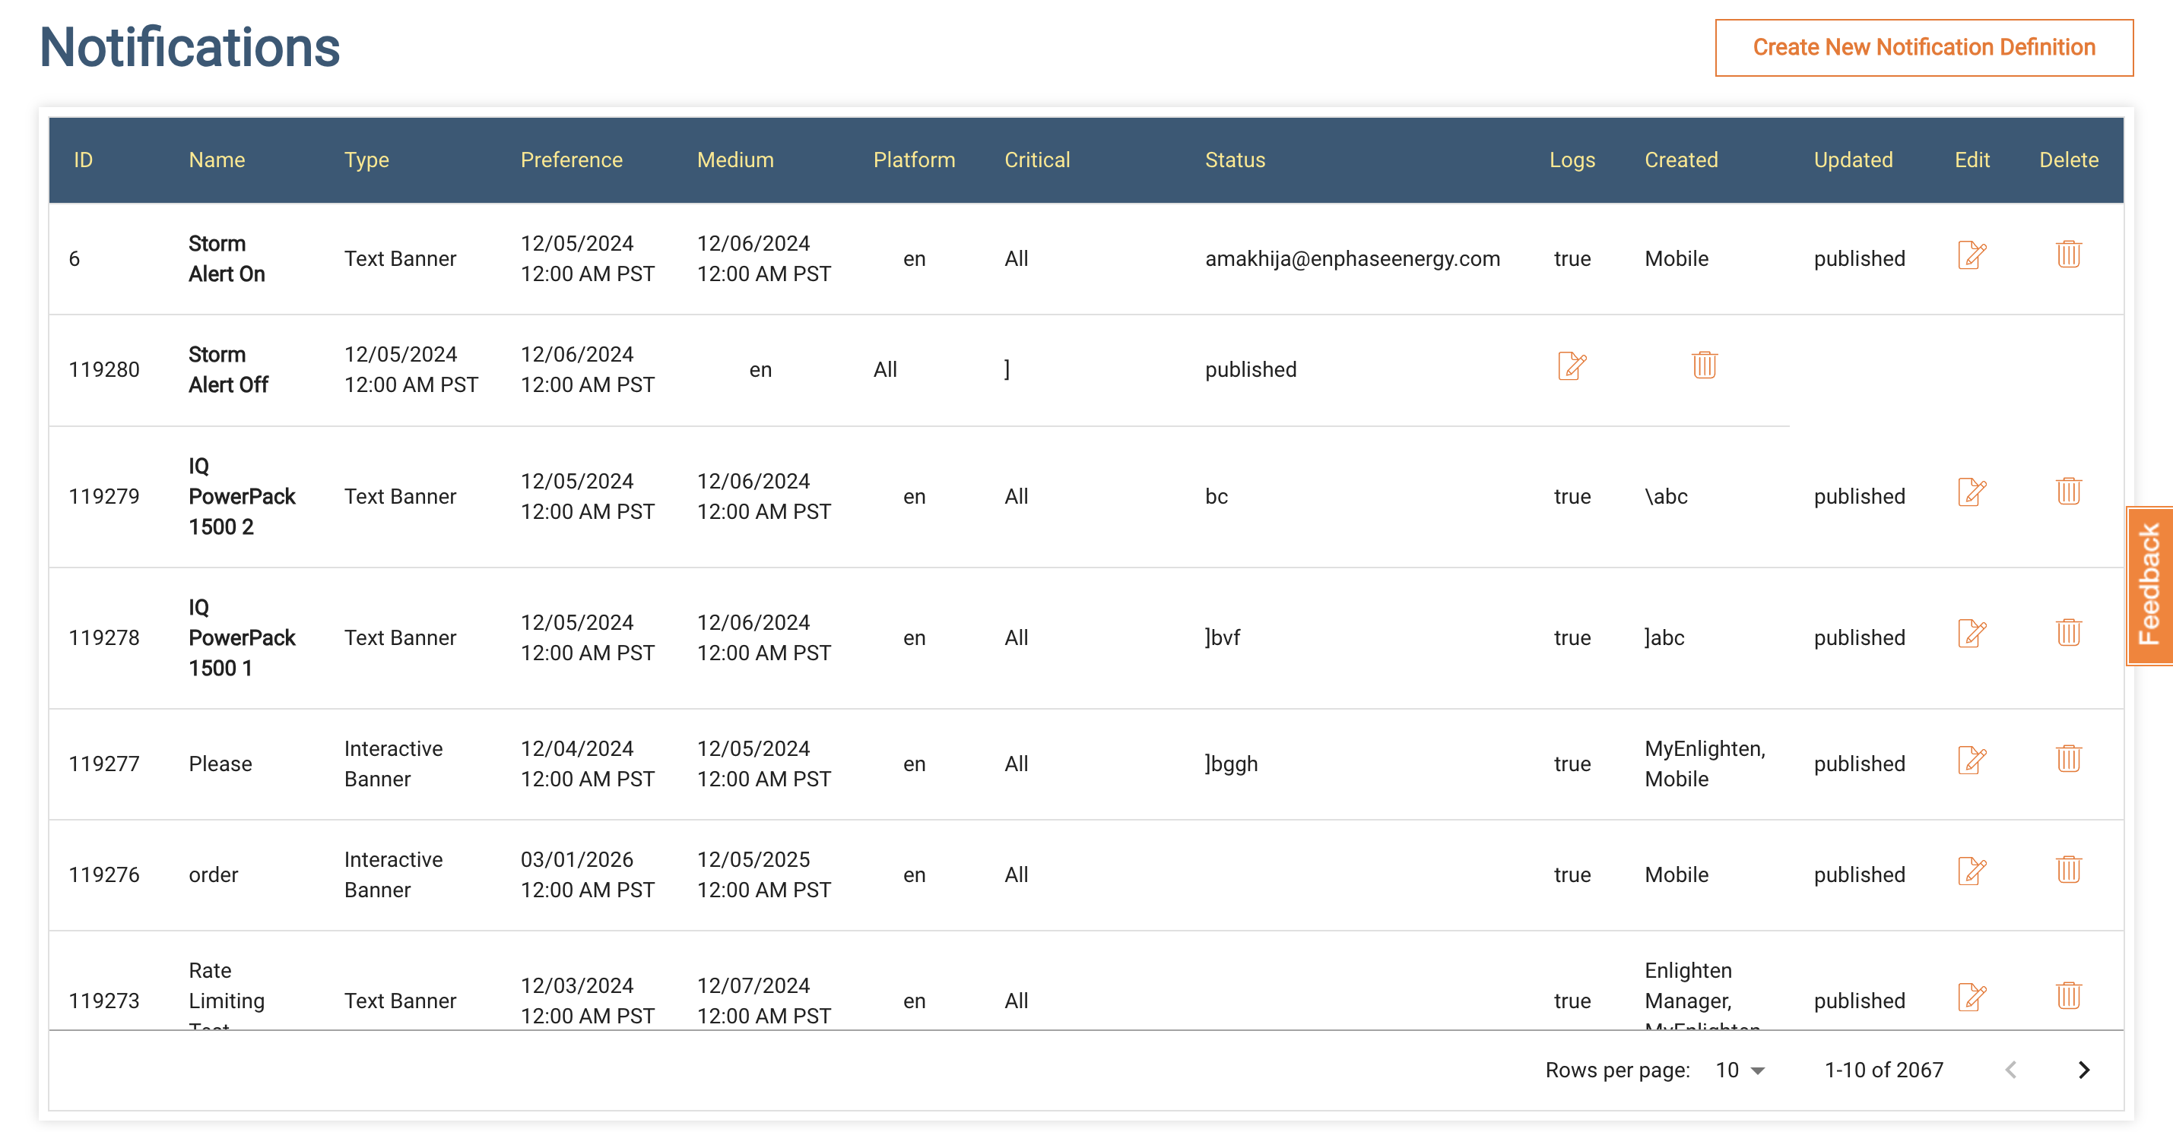
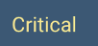

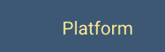


Notificatin source file
1
Gateway not reporting
Yes
Errors
PUSH, Email, SMS, In-app
ENHO, ENLAM, MyENL
Active
3/30/2025
10:00 AM PST
3/30/2025
10:00 AM PST
2
Micros not reporting
Errors
PUSH, Email, SMS, In-app
ENHO, ENLAM
3/30/2025
10:00 AM PST
3/30/2025
10:00 AM PST
Yes
ENHO, ENLAM, MyENL
Active
3
Battery not reporting
Yes
Errors
PUSH, Email, SMS, In-app
ENHO, ENLAM, MyENL
Active
3/30/2025
10:00 AM PST
3/30/2025
10:00 AM PST
4
System Controller not reporting
Yes
Errors
PUSH, Email, SMS, In-app
ENHO, ENLAM, MyENL
Active
3/30/2025
10:00 AM PST
3/30/2025
10:00 AM PST
5
Grid Outage
Yes
Alerts
PUSH, Email, SMS
NA
Active
3/30/2025
10:00 AM PST
3/30/2025
10:00 AM PST
5
6
Alerts
PUSH, Email, SMS
Active
3/30/2025
10:00 AM PST
3/30/2025
10:00 AM PST
6
On Grid
Yes
NA
7
Storm Alert: On
PUSH, Email, SMS
Active
3/30/2025
10:00 AM PST
3/30/2025
10:00 AM PST
7
Yes
Alerts
NA

Slide 27
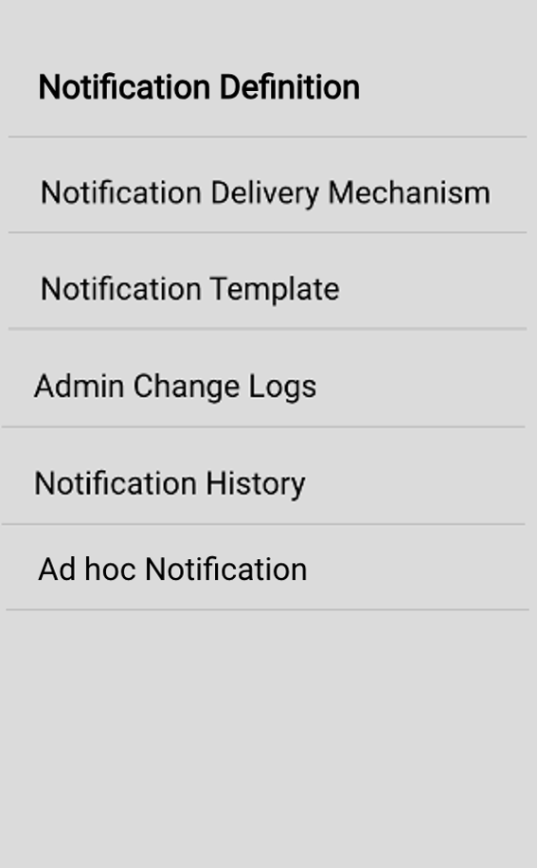
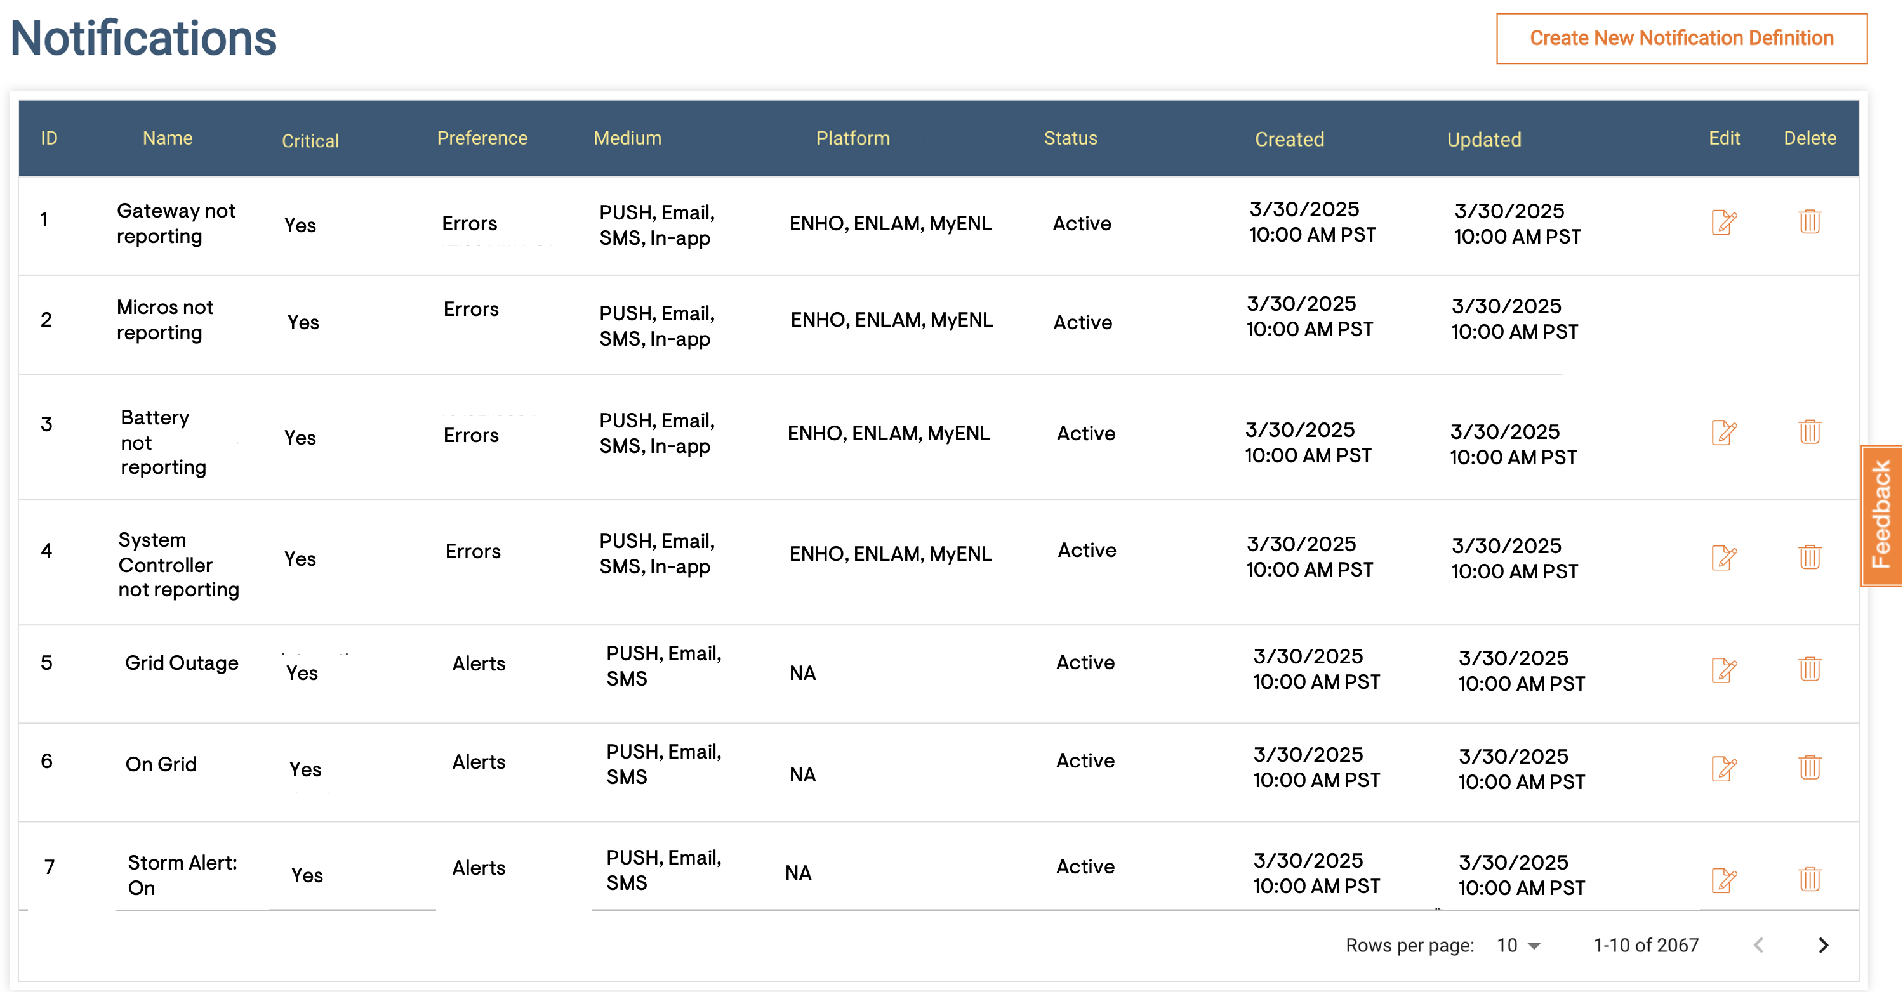

Notification source file 2

Slide 28
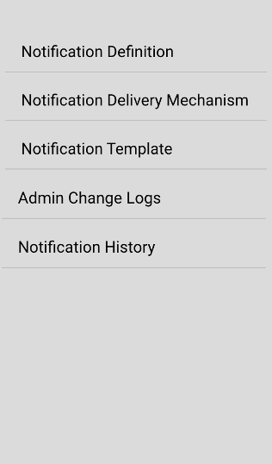
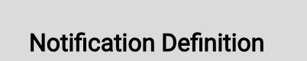
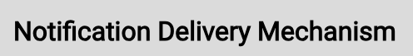
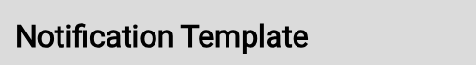
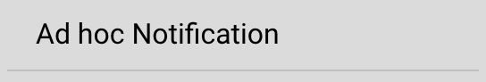
Source file

